Slide 4
What is an Ellipse?
An ellipse is a geometric shape that results from viewing a circular shape in perspective, or from a different vantage point. In simple terms, an ellipse is an oval. Depending on the vantage point of the viewer, an ellipse results from the distortion of an object that is circular i

Slide 5
Methods of construction Ellipse

Slide 6
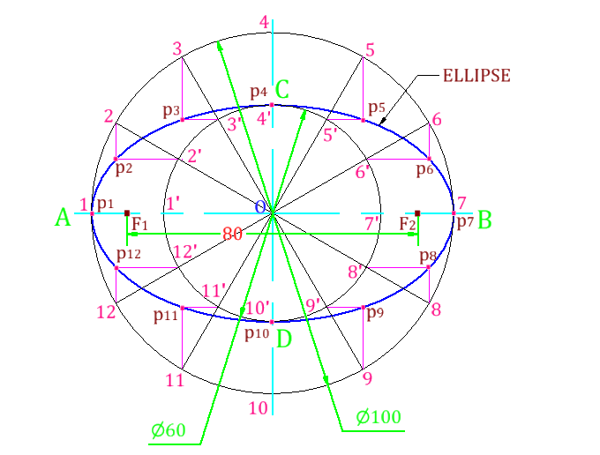

Slide 7
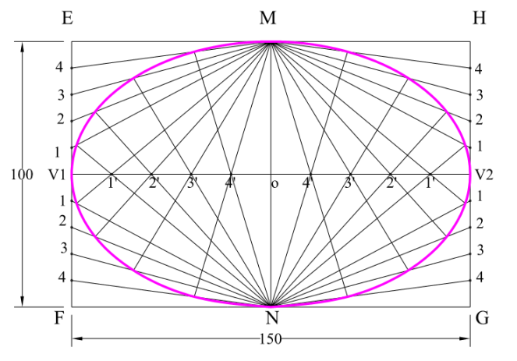

Slide 8
